Slide 1
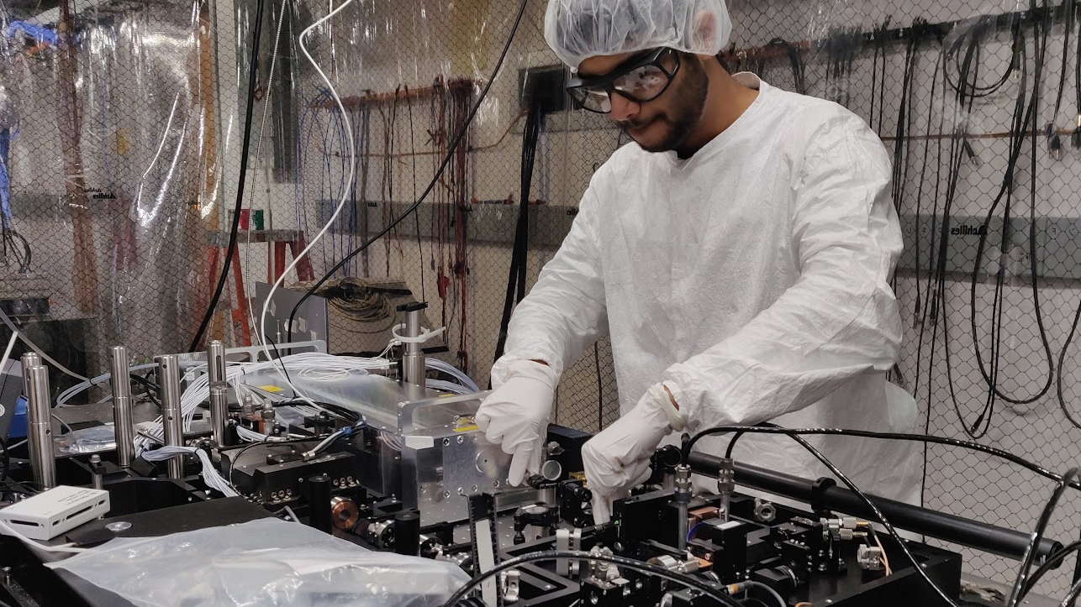
From Individual Atoms to Quantum Computers
Debopriyo Biswas

Slide 2
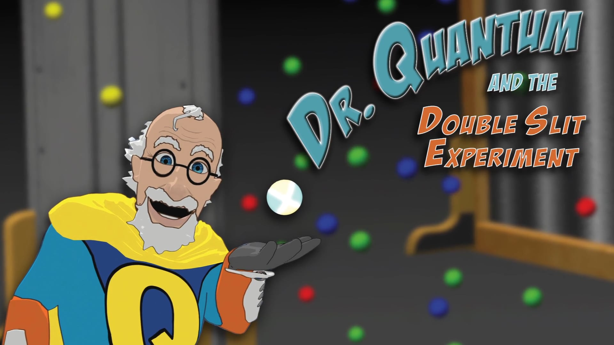
About me
In class 10, my physics teacher showed me a quantum physics video that changed my life trajectory

Slide 3
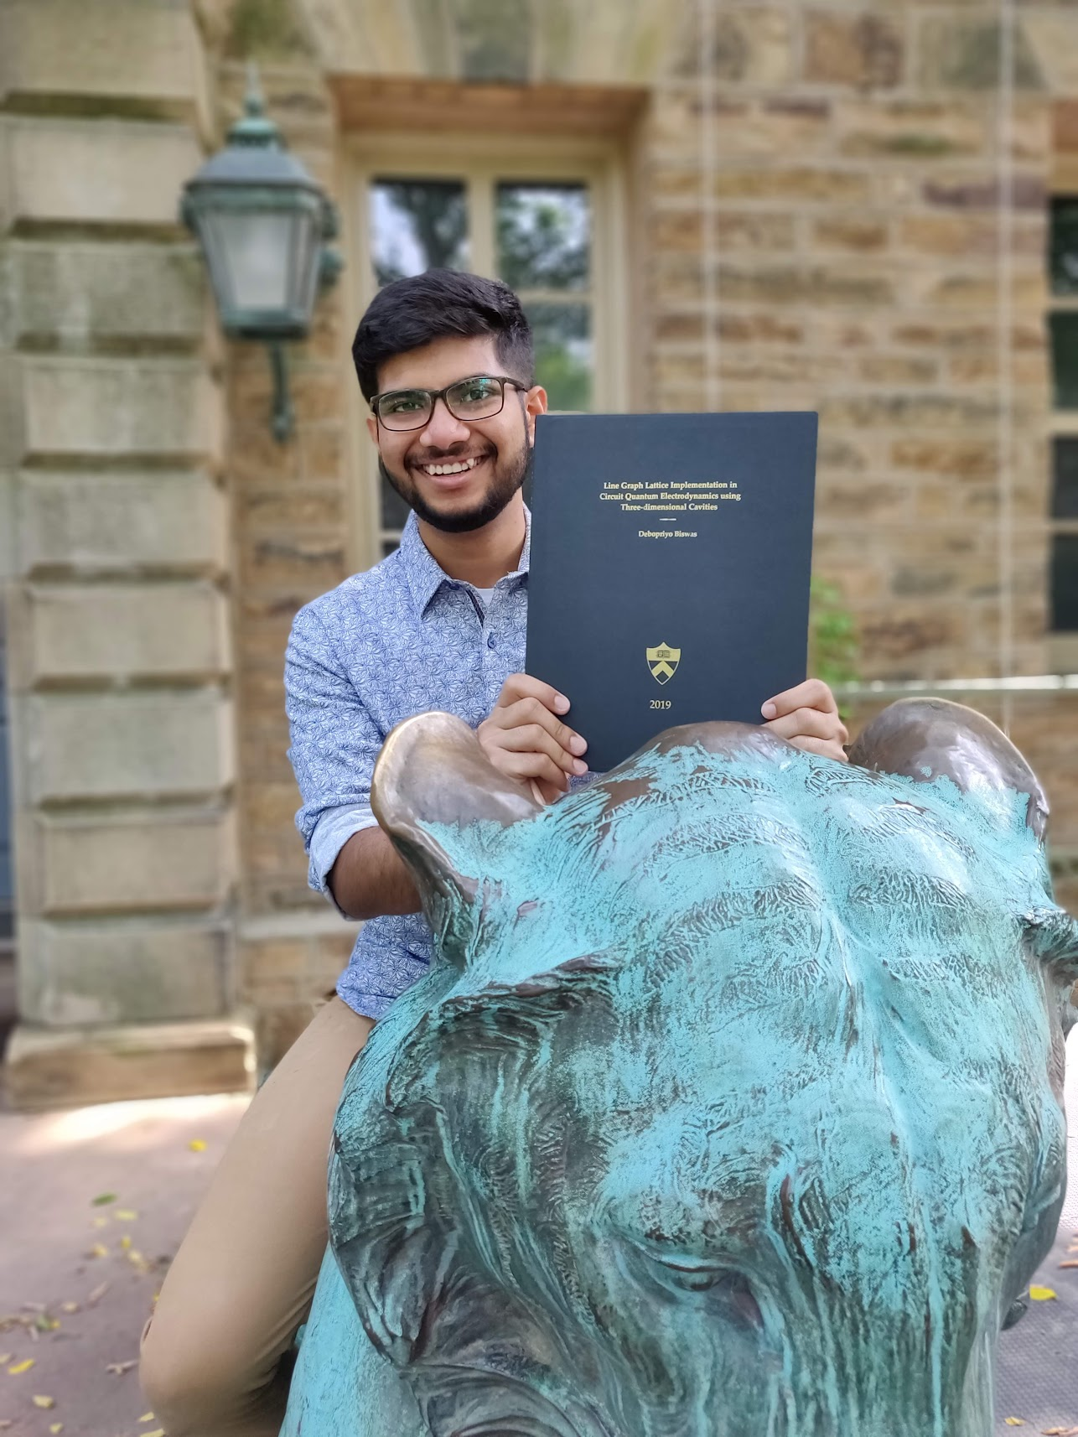
About me
At Princeton University, I did research on quantum simulations using 3D cavity QED.

Slide 4
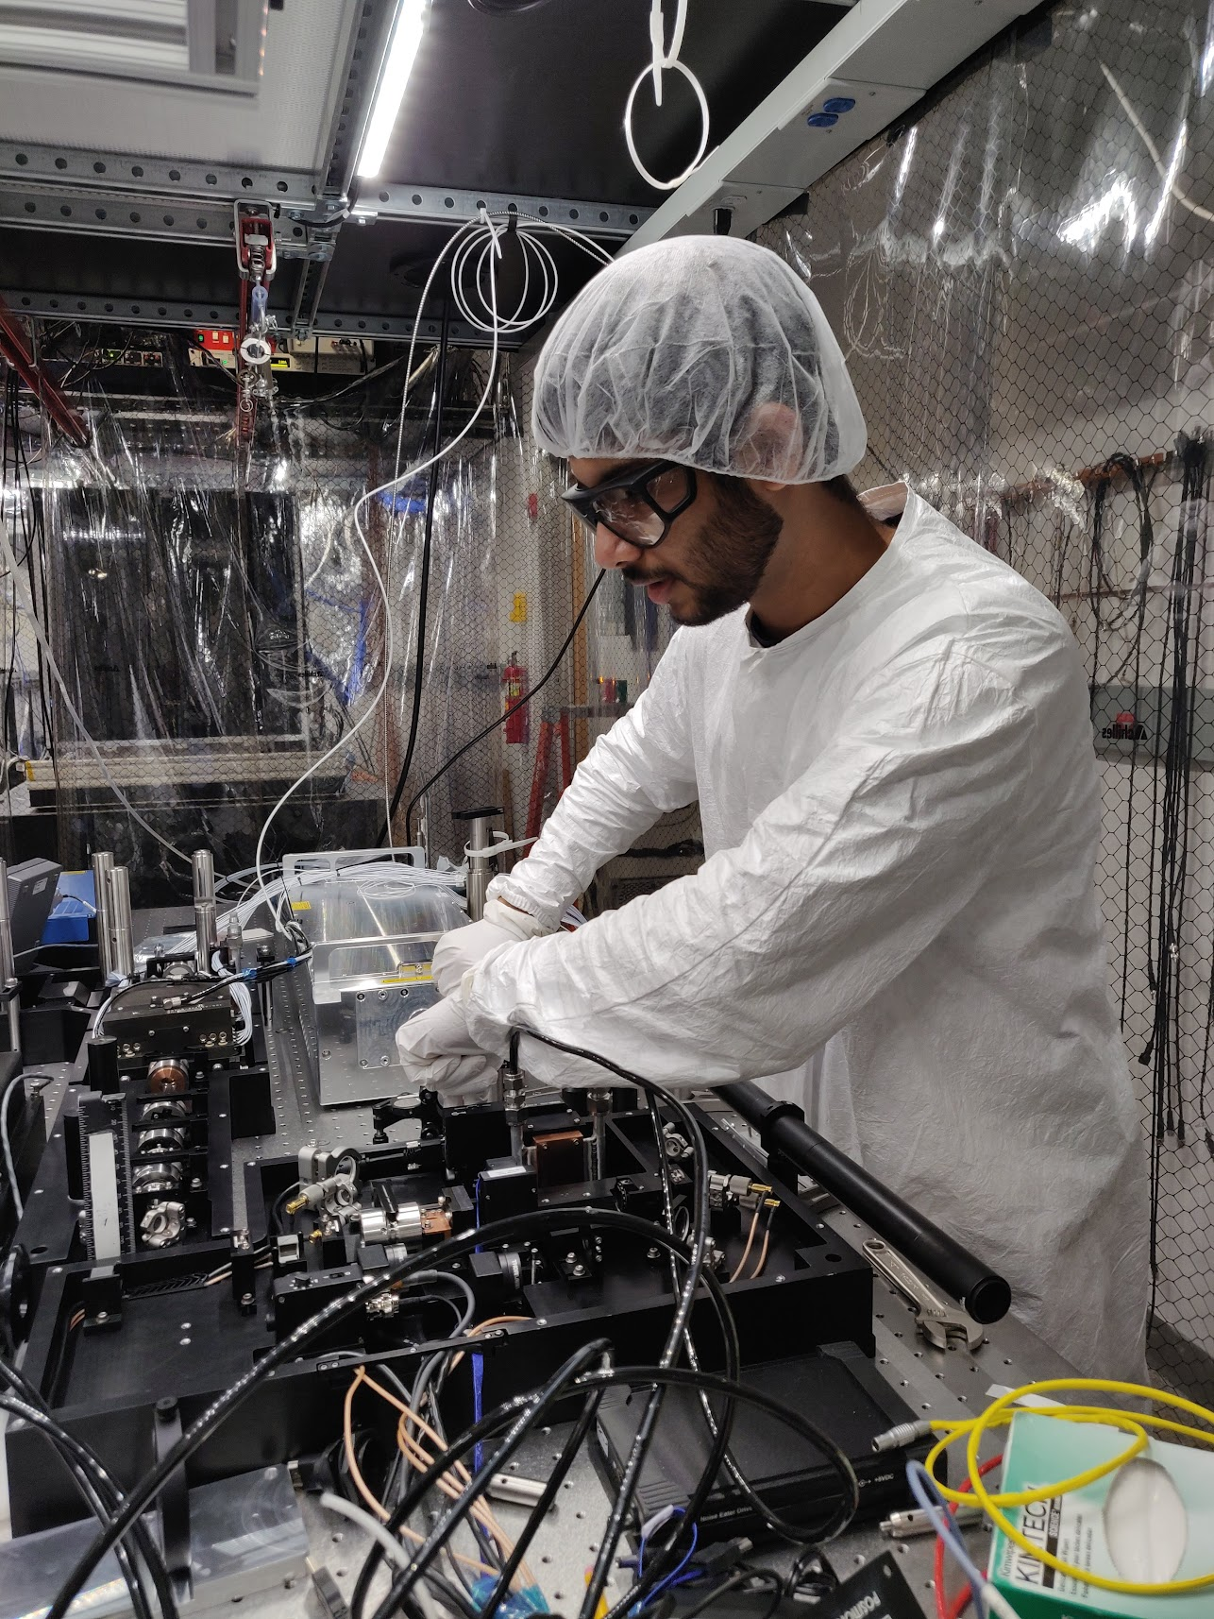
About me
At UMD → Duke, I’ve been doing PhD research on quantum computing using trapped ions.
Projects:
Quantum error correction
Digital quantum simulation
Holography and quantum gravity

Slide 5
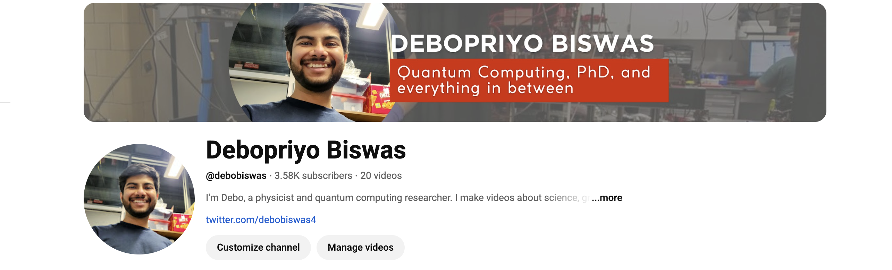
I make videos about Quantum Computing!

Slide 6
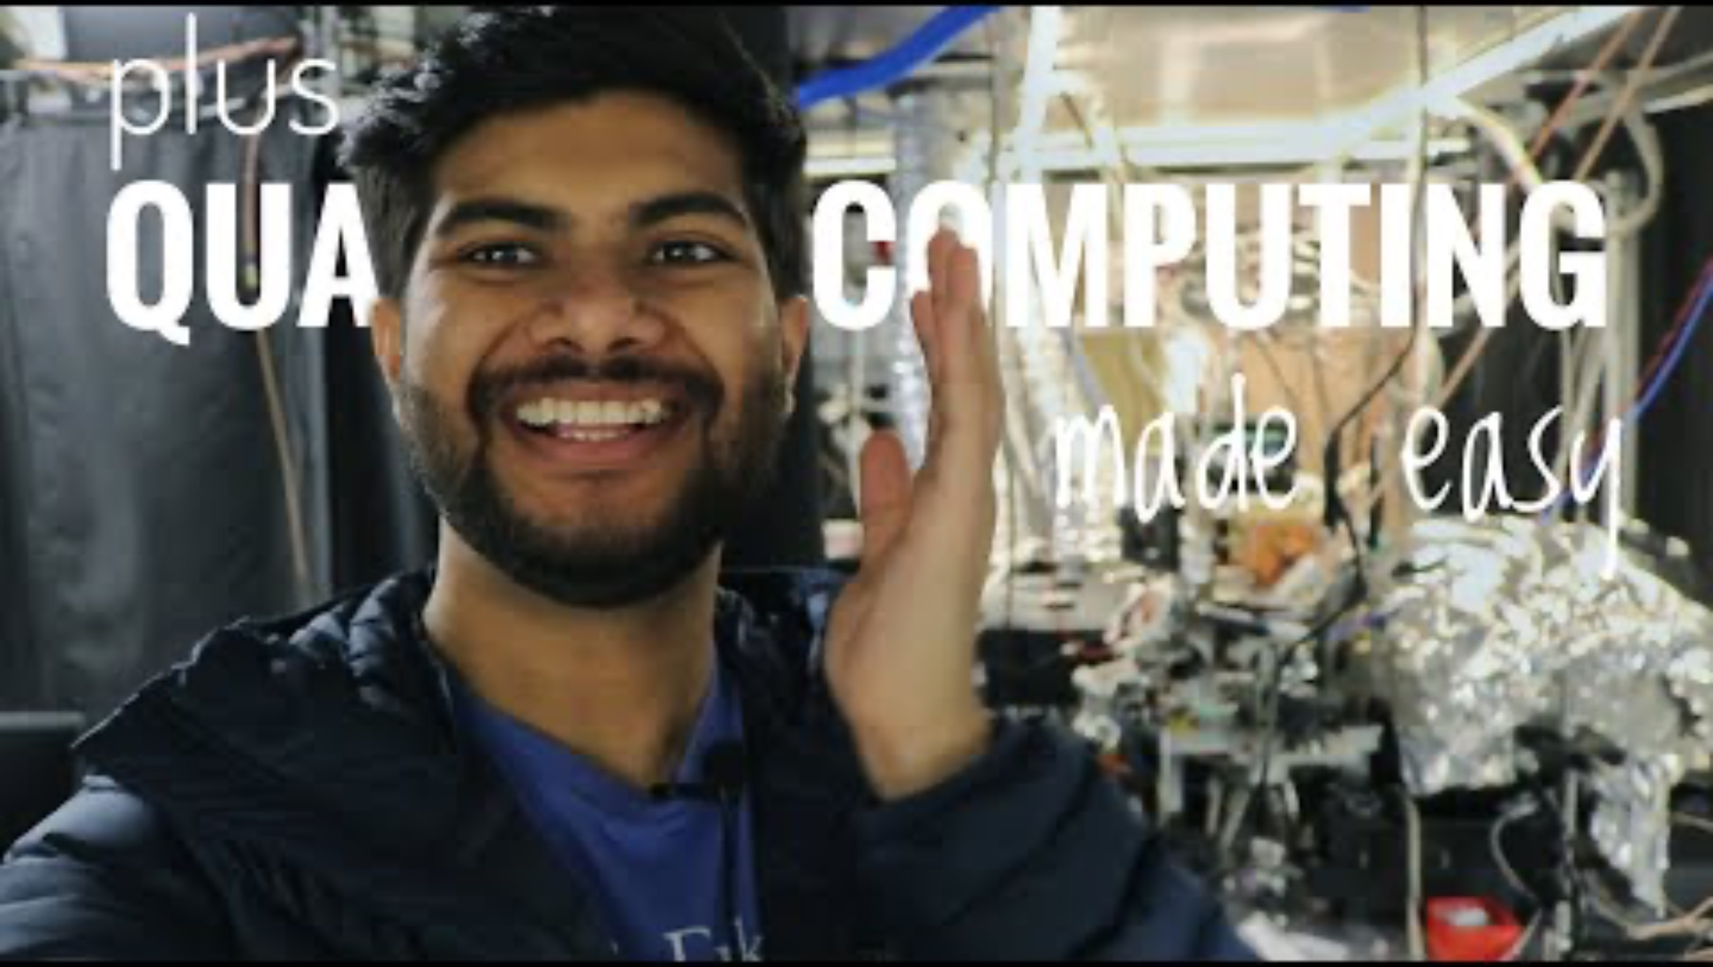
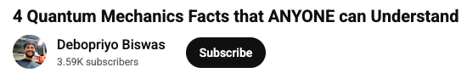
Let’s watch a video clip about Qubits & Quantum Computers:

Slide 7

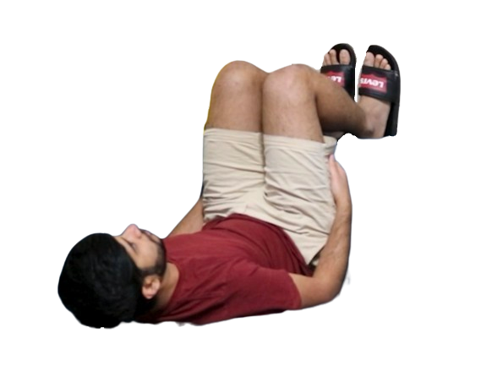
Superposition
|ψ⟩ = α| ⟩+β| ⟩
2 possible qubit states from the video example

Slide 8

Measurement
|ψ⟩ = α| ⟩+β| ⟩

Slide 9
Collapse
|ψ⟩ = α| ⟩+β| ⟩
probability ~ |α|²

Slide 10
Entanglement
|ψ⟩ = α| ⟩ +β| ⟩

Slide 11
Entanglement
|ψ⟩ = α| ⟩ +β| ⟩

Slide 12
Entanglement
|ψ⟩ = α| ⟩ +β| ⟩
probability ~ |β|²

Slide 13

Spins ↔ Qubits ↔ Atoms ↔ Ions
|ψ⟩ = α| ⟩ +β| ⟩ or α|↑⟩ +β|↓⟩
or α| 1 ⟩ +β| 0 ⟩ or α| ⟩ +β| ⟩

Slide 14
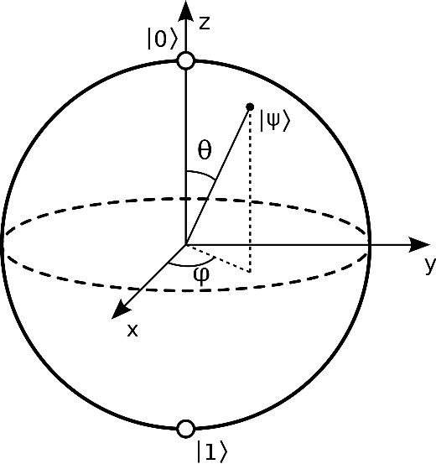

Bloch Sphere picture for qubits
Picture source: Wikipedia

Slide 15
Trapped Ions as Qubits

Slide 16
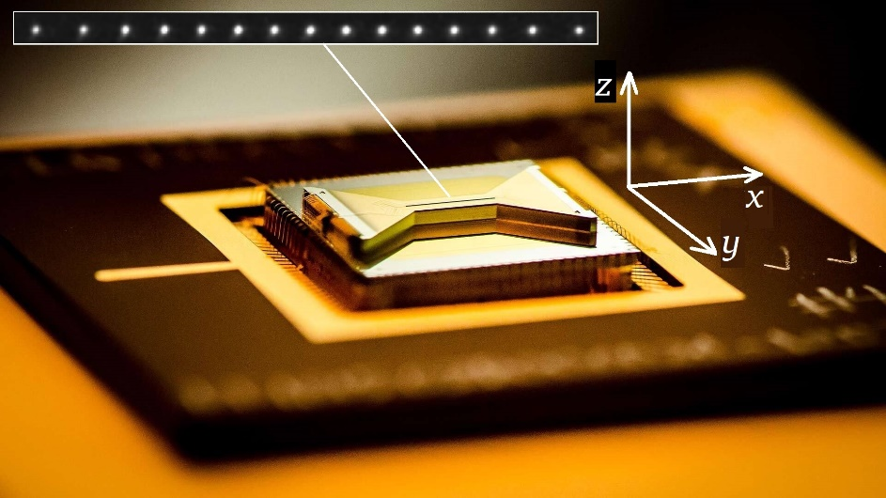
Trapped Ions as Qubits
¹⁷¹Yb⁺ ions
4 µm
Microfabricated surface ion trap

Slide 17
Trapped Ions as Qubits
¹⁷¹Yb⁺ ions
Features:
Trap ions using electric fields
Address ions/qubits using lasers
Qubits are perfectly identical
Record high coherence times and operational fidelity
Shared motion → all-to-all connectivity
4 µm
Microfabricated surface ion trap

Slide 18
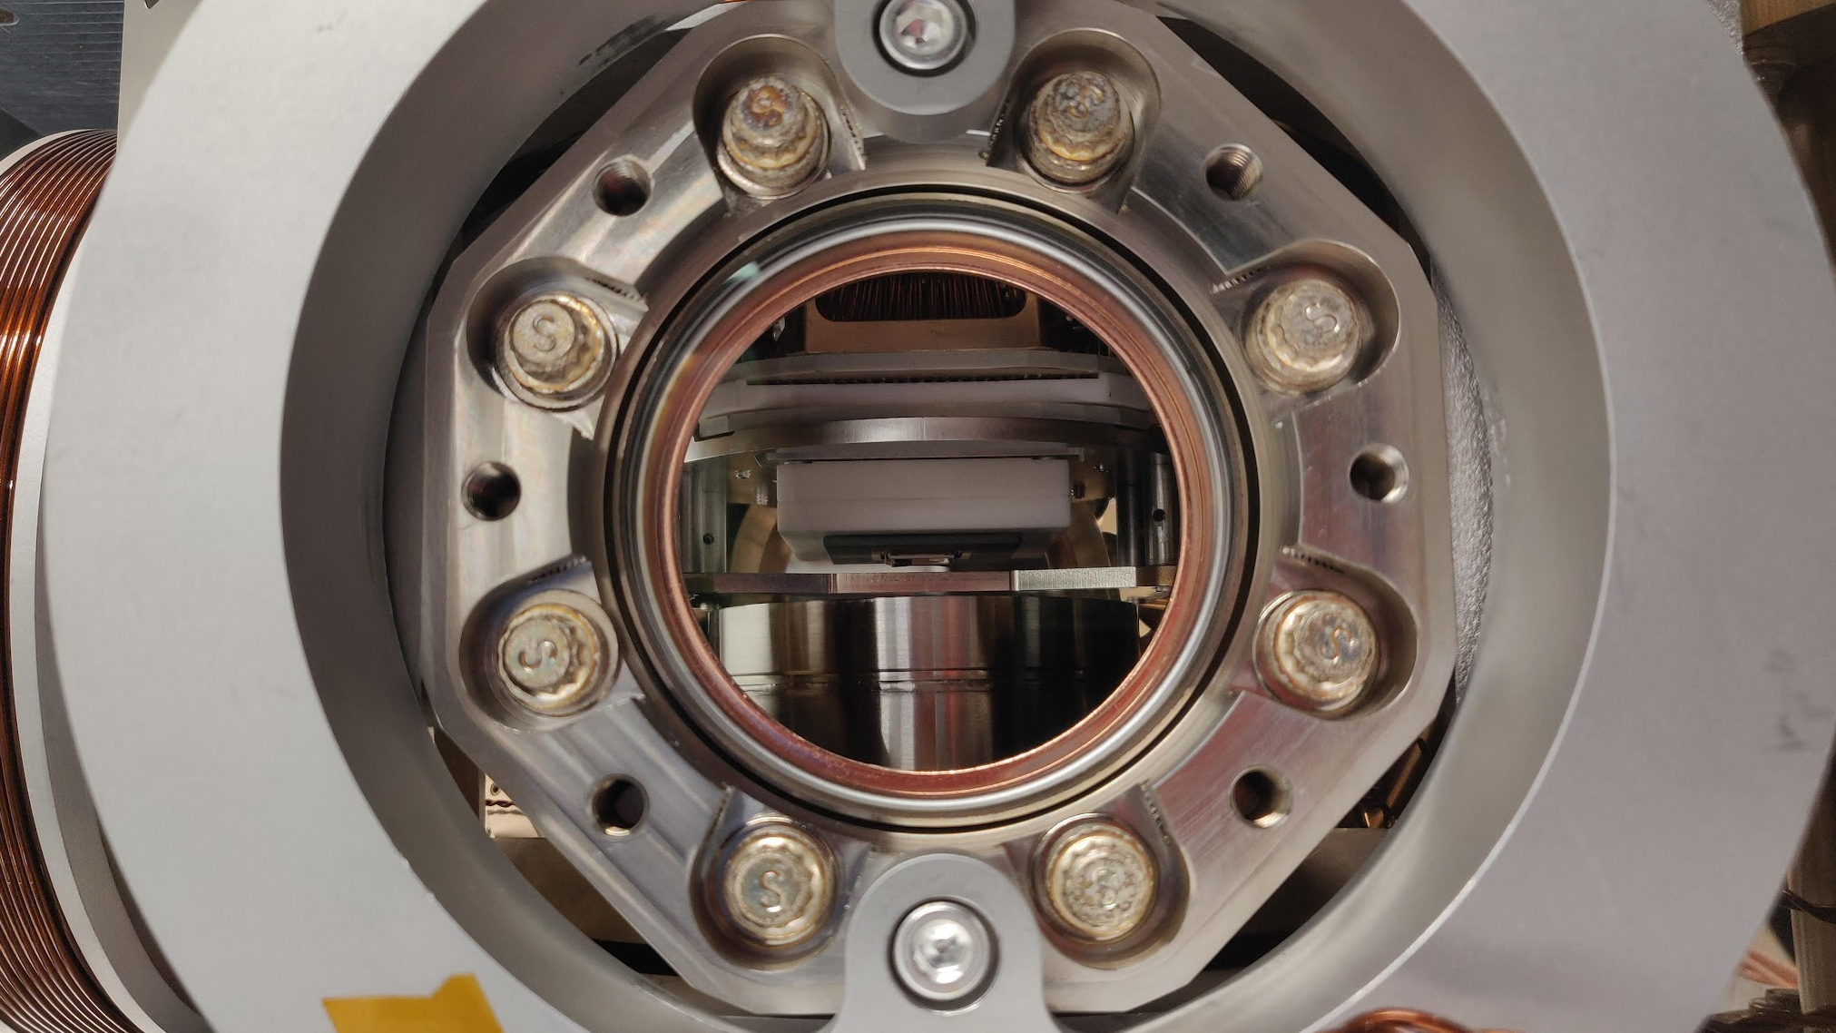
Surface Trap inside Vacuum Chamber
Surface Ion trap

Slide 19
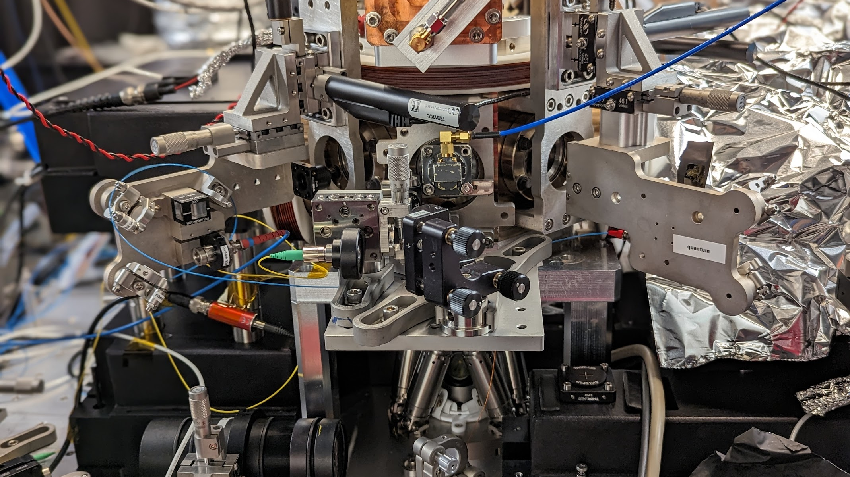
Chamber with laser beam alignment plates
Optical fiber carries laser cooling beam and other beams
Detection optics

Slide 20
Let’s take a tour!

Slide 21
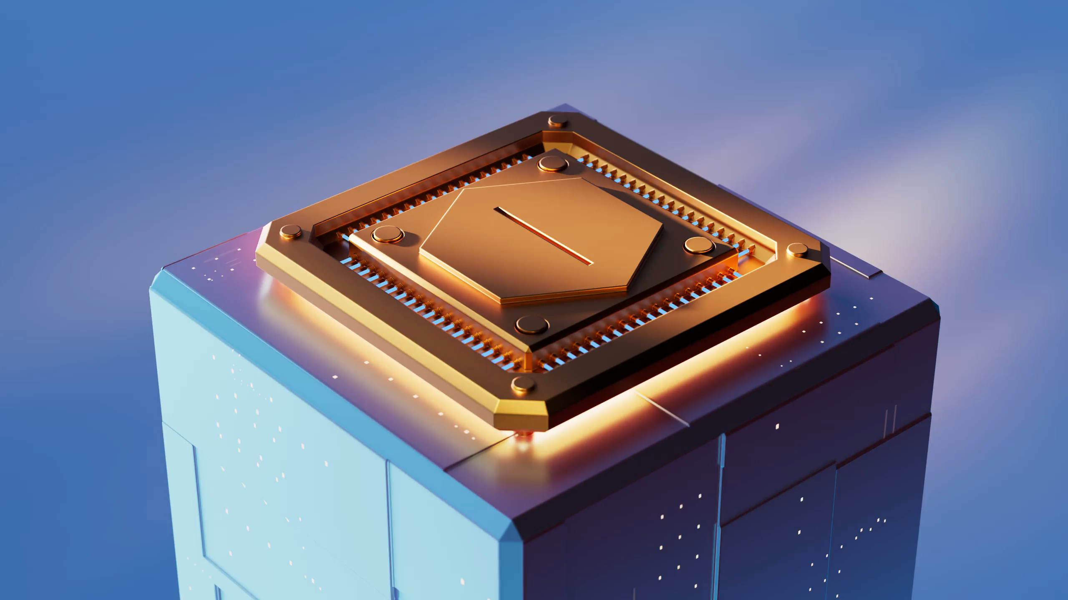
Animation of trapped ions
Source: The Quantum Atlas
Credit: Olena Shmahalo

Slide 22
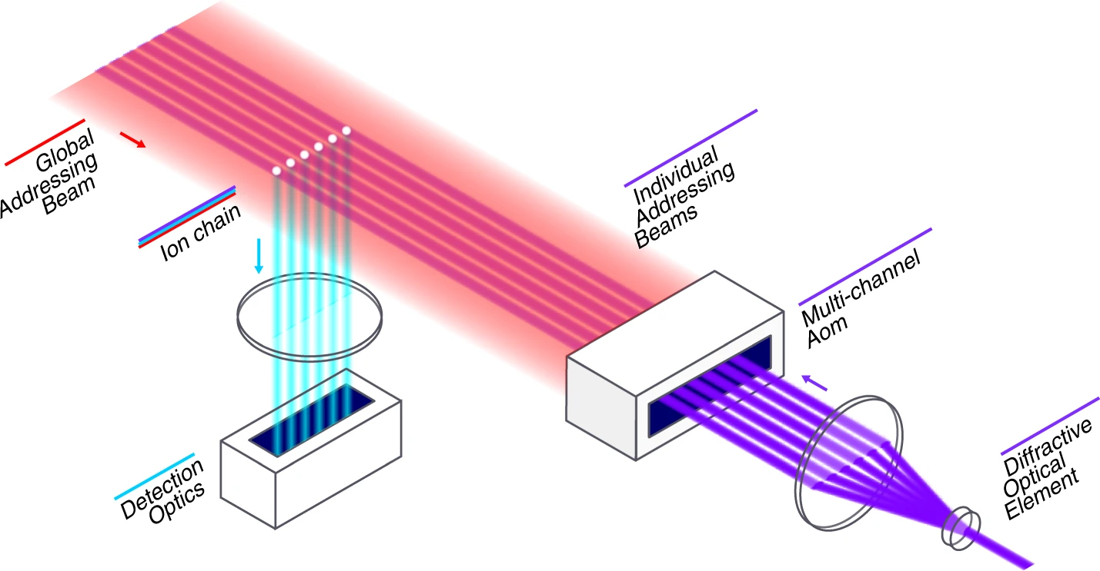
Schematic of trapped ion QC hardare
Source: Wright, K., Beck, K.M., Debnath, S. et al. Nat Commun 10, 5464 (2019)

Slide 23
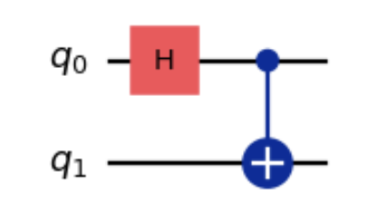
Running a quantum circuit
A sequence of quantum gates acting on qubits.

Slide 24
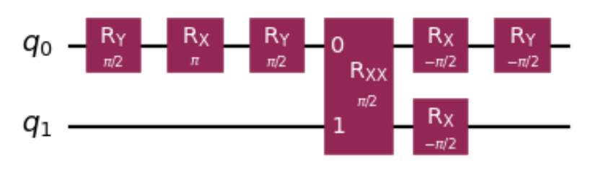
Running a quantum circuit
A sequence of quantum gates acting on qubits. Transpile given circuit to native gates (which is basically translating to a language that the specific quantum hardware will understand)

Slide 25
Running a quantum circuit
A sequence of quantum gates acting on qubits.
Each single-qubit gate like R_{x}(θ) rotates |ψ⟩ around x-axis by angle θ in the Bloch sphere picture
Bloch sphere.
Source: Wikipedia

Slide 26
Keep exploring!
Quantum Simulation
Analog Simulation
Digital Simulation
Quantum Chemistry
High-Energy / Gravity
Quantum Computing
Algorithms
Fault Tolerance
Compilation & Transpilation
Quantum Architectures
This was only a small flavor of quantum information science.
There’s lots more out there!
Q. Information Theory
Entanglement
Complexity Theory
Quantum Error Correction
Quantum Shannon Theory
Quantum Networking
Quantum Repeaters
Entanglement Swapping
Distributed Q. Computing
Quantum Memories
Quantum Cryptography
Quantum Key Distribution
Post-Quantum Cryptography
Randomness Generation
Quantum Hardware & Engineering
Trapped Ions
Superconducting Qubits
Neutral Atoms
Photonic Systems
Q. Sensing & Metrology
Atomic Clocks
Magnetometry
Dark-Matter detection
Precision Measurement

